Slide 1
Data Science and Artificial Intelligence: Project 1
Multilingual Customer Support Email Tickets
Submitted By :-
Name: Himakshi

Slide 2
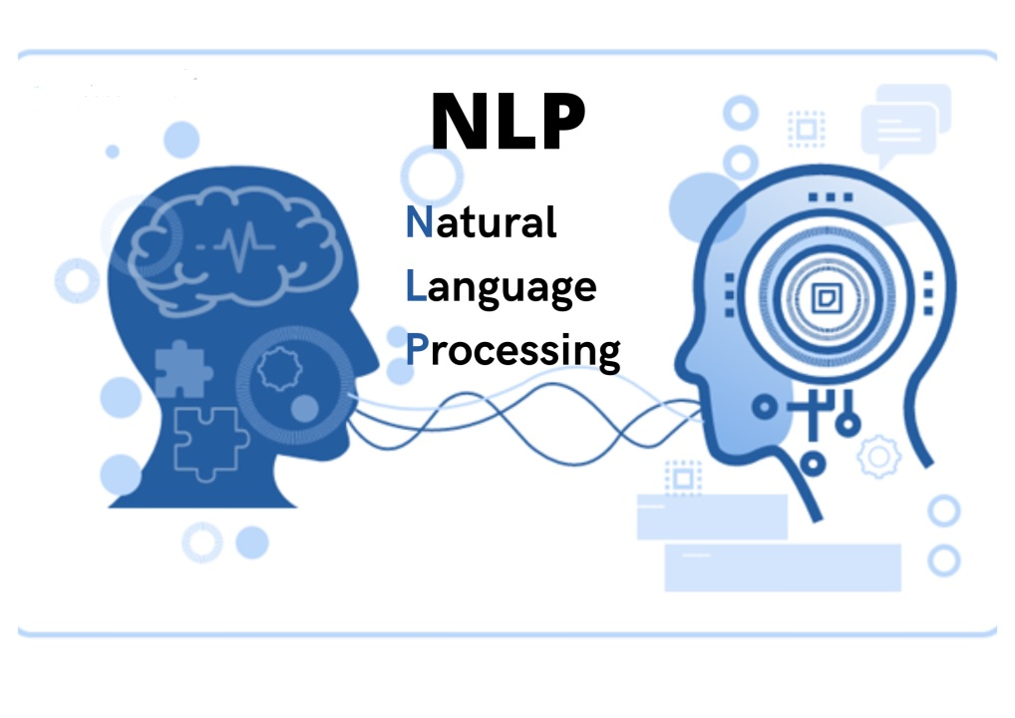
Project Outline
Background
Objective
Issue and Challenges of ABC University
Resources
Outcome
Approach
Data Preprocessing
Analytical Techniques
Tokenizer and Model
Model Performance
Result Summary
Recommendations
Benefits to the Organization
Bibiliography

Slide 3

Background
ABC University is a unique and inspirational academic institution designed to match the international standards.
ABC University has a dynamic academic fraternity drawn from top universities nationally and internationally.
ABC University students come not only from Indian states, but the student inflow is from over 50+ Nations.

Slide 4

Objectives
Enhance Email Ticket Classification
Improve Multilingual Understanding
Optimize Resource Allocation
Increase Accuracy of Ticket Handling

Slide 5

Issue and Challenges of ABC University
ABC University believes in providing the best support to foreign student. The biggest barrier was of language for the same university need to improve handling of student support across diverse languages (e.g., English, Spanish, Mandarin).
Challenges: Interpretation of student messages, accurate categorization, and timely response generation.

Slide 6

Resources
Google Colab
ML Frameworks (Libraries, NLP Tools)
Data Visualization Tools(Software)
Integrated Tools (APIs and Connectors)
Datasets

Slide 7

Outcomes
Enhanced student satisfaction with timely responses in preferred languages.
Streamlined operations through automated language detection and ticket routing.
Improved service quality metrics (response times, resolution rates).

Slide 8

Approach
Implement a solution to enhance multilingual customer support email tickets.
Implementing algorithms for automated ticket categorization.
Continuously refine algorithms based on data-driven insights
Problem understanding, data collection, preprocessing, model development, and deployment.

Slide 9
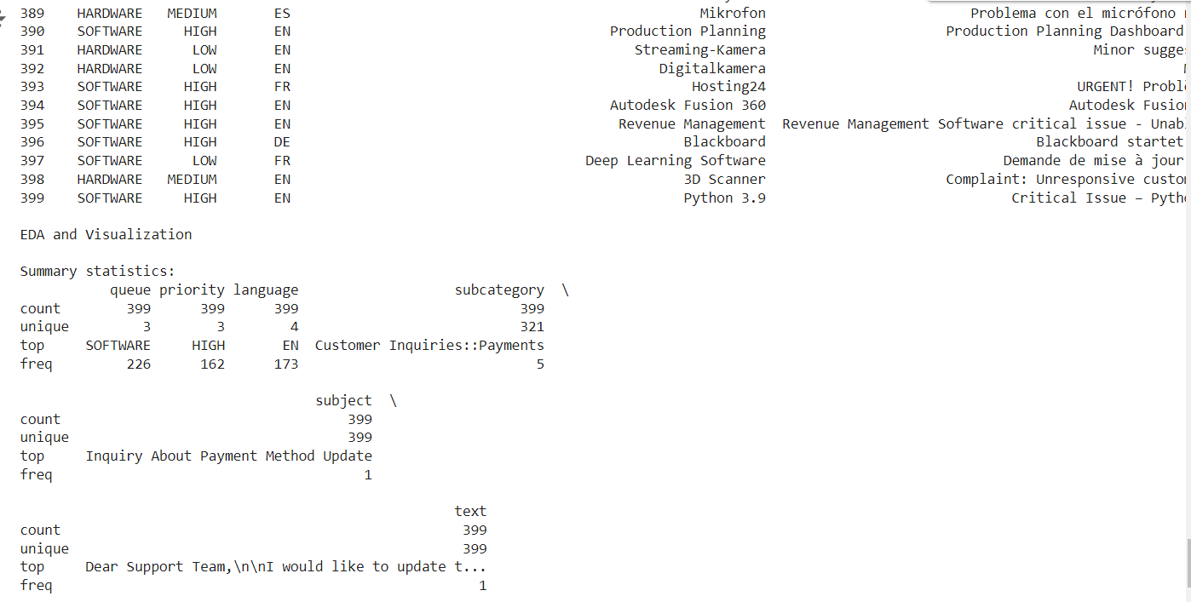
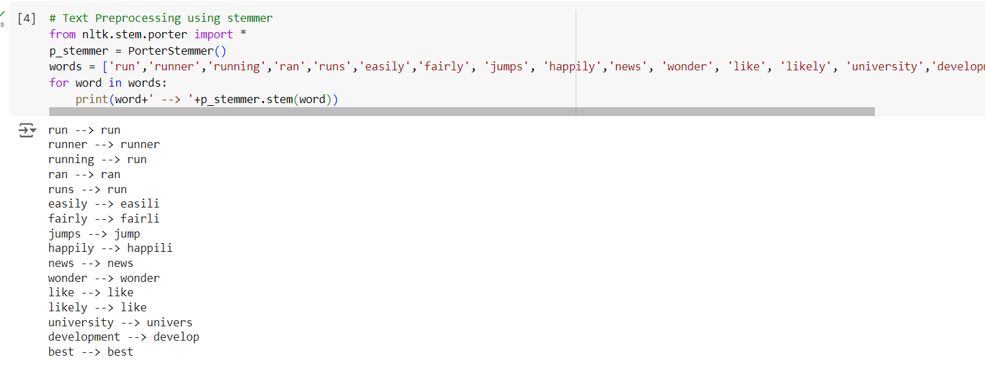
Data Preprocessing
Tokenization: Break down text into individual words or tokens.
Stopwords Removal: Eliminate common words that do not contribute to the meaning.
Stemming and Lemmatization: Reduce words to their base or root forms.
TF-IDF Vectorization: Convert text into numerical format considering term frequency and inverse document frequency.

Slide 10
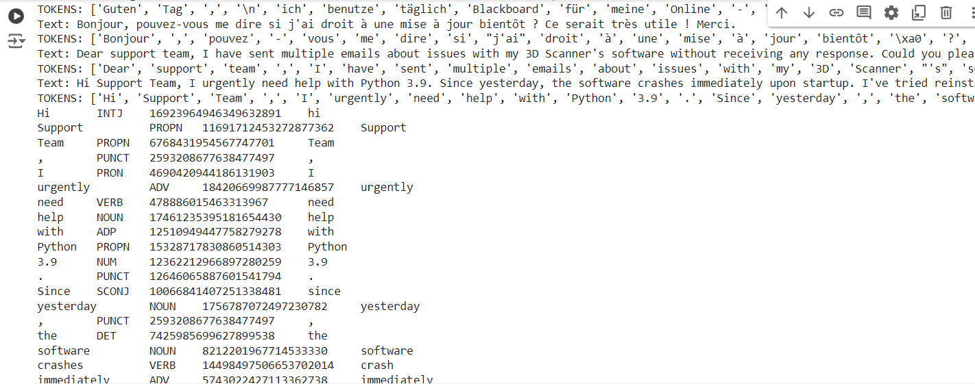
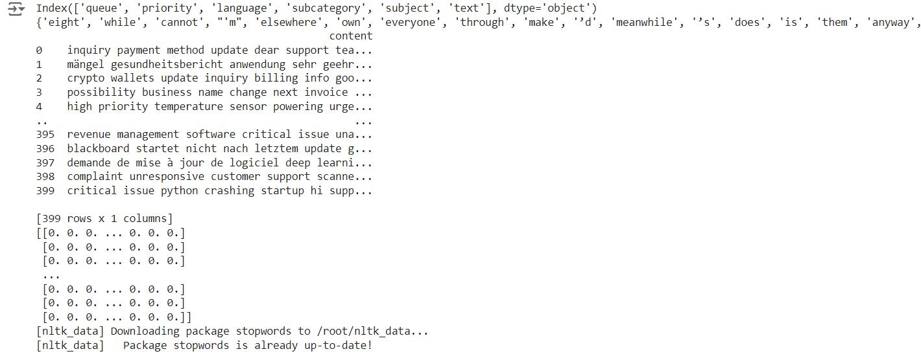
Data Preprocessing
Tokenization: Break down text into individual words or tokens.
Stopwords Removal: Eliminate common words that do not contribute to the meaning.
Stemming and Lemmatization: Reduce words to their base or root forms.
TF-IDF Vectorization: Convert text into numerical format considering term frequency and inverse document frequency.

Slide 11
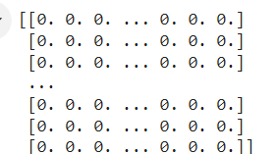
Analytical Techniques
TF-IDF Vectorization: Transforms text data into a format suitable for machine learning models by reflecting the importance of terms in documents.
Outcome: Captured the essential features from text data for classification.

Slide 12
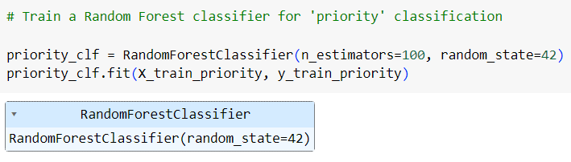
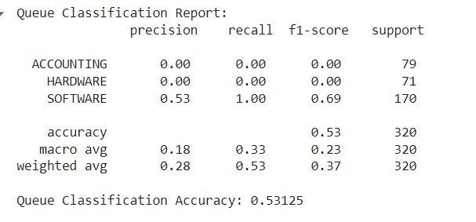
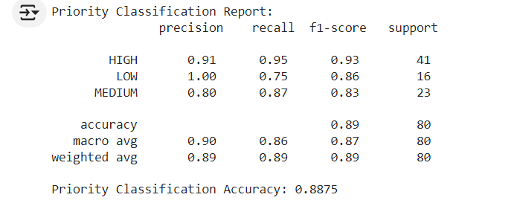
Analytical Techniques
Random Forest Classifier: A robust ensemble learning method that combines multiple decision trees to improve classification accuracy.
Outcome: Achieved high accuracy in ticket classification.

Slide 13
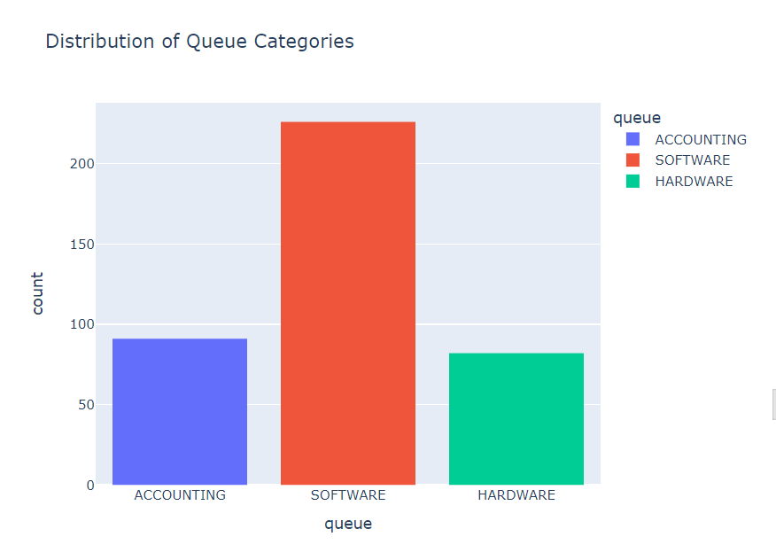
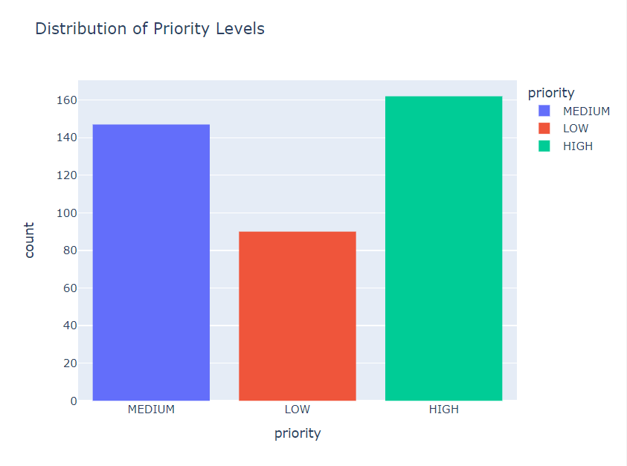
Analytical Techniques
Distribution of data analysis through Queue, priority and language:-
Queue: Identify the common queue lengths and any significant patterns or outliers. Highlight the most frequent queue length range.
Priority: Determine how many tickets fall into each priority category and assess if the distribution aligns with expectations. Identify the most common priority level and Analyze if there are sufficient resources allocated for high-priority tickets.

Slide 14
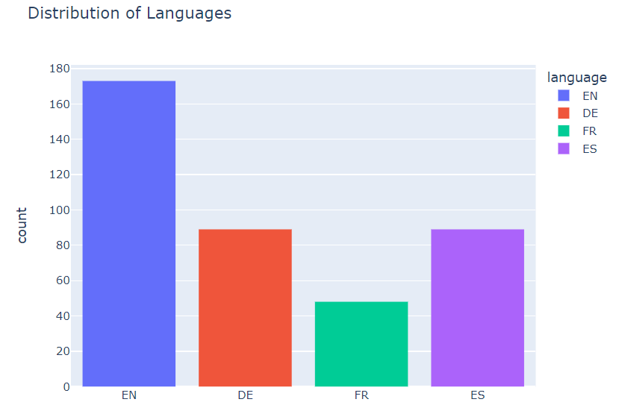
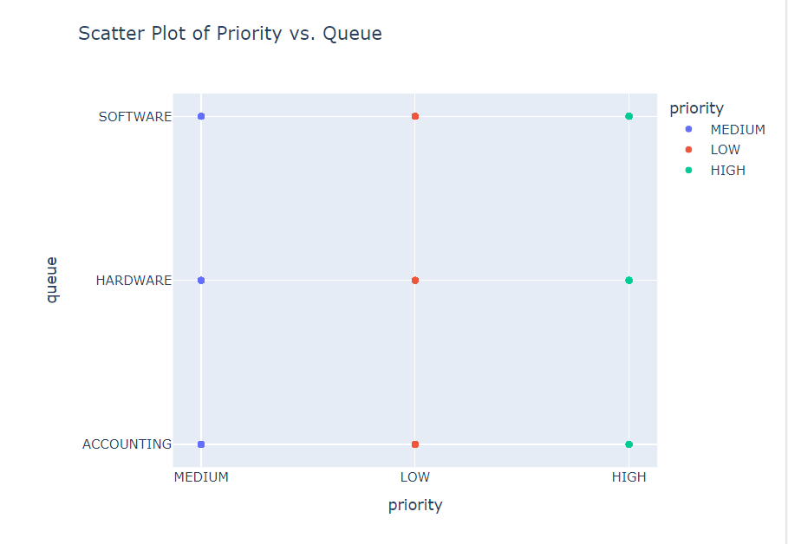
Analytical Techniques
Language: Assess the multilingual nature of the ticket data and any language-related trends. Highlight the most frequently used languages and if there is a need for additional language support based on the distribution.
Scatter Plot: A positive correlation means that as one variable increases, the other does too; a negative correlation means that as one variable increases, the other decreases.

Slide 15
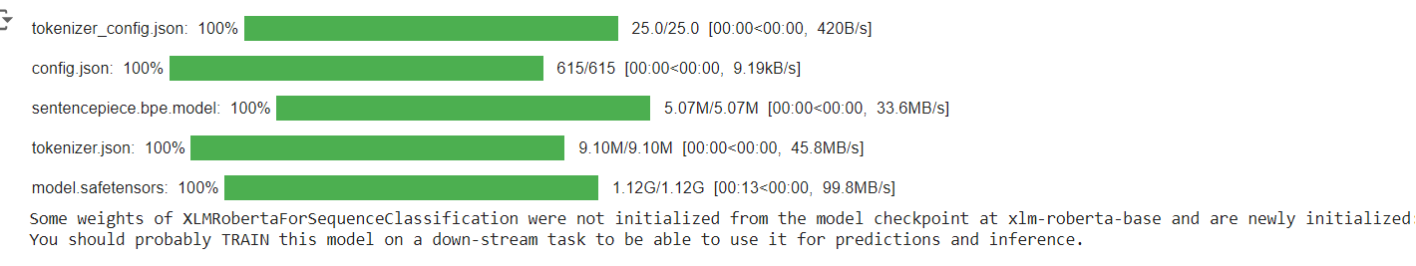
Tokenizer & Model
Pre-trained Tokenizer: Used for converting text into tokens that the model can understand.
Pre-trained Model: Leveraged for multilingual understanding and accurate ticket classification.

Slide 16
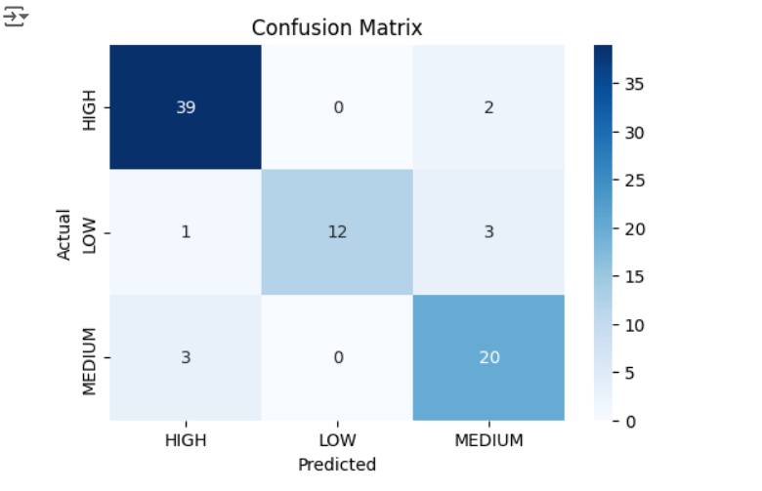
Model Performance
Confusion Matrix: Evaluates the performance of the classification model by comparing predicted and actual values.
Outcome: Provides a clear view of classification accuracy and errors.
Example:- Predicting the priority for new tickets

Slide 17
Result Summary
Increased Classification Accuracy: Achieved 0.8875 accuracy in ticket categorization.
Efficient Multilingual Support: Effective handling of tickets in 10+ languages.
Optimized Resource Allocation: Reduced processing time and cost.

Slide 18
Recommendations
Expand Multilingual Capabilities: Include additional languages based on student demographics.
Regularly update and refine algorithms: Implement or enhance existing language detection algorithms to automatically identify and categorize tickets by language.
Utilize Real-Time Analytics: Incorporate real-time analytics to monitor ticket classification performance and user interactions.
Optimize Data Collection and Management: Improve data collection methods and maintain comprehensive and up-to-date datasets for training and evaluation.
Implement Multi-Tiered Ticket Prioritization: Develop a multi-tiered prioritization system based on ticket urgency, language, and other factors.

Slide 19

Benefits to the Organization
Enhanced Efficiency: Faster ticket resolution and reduced manual intervention.
Improved Accuracy: Fewer misclassifications leading to better customer service.
Scalability: System capable of handling increased ticket volumes.

Slide 20
Bibliography
Source web site :
https://www.kaggle.com/datasets/tobiasbueck/multilingual-customer-support-tickets/data
https://scikit-learn.org/stable/modules/neural_networks_supervised.html#classification
https://www.w3schools.com/python/python_ml_confusion_matrix.asp
https://www.geeksforgeeks.org/understanding-tf-idf-term-frequency-inverse-document-frequency/
https://scikit-learn.org/stable/modules/generated/sklearn.feature_extraction.text.TfidfVectorizer.html
https://www.youtube.com/watch?v=okcqWyAzo4k&t=920sl
https://www.youtube.com/watch?v=bPrmA1SEN2k&list=PLZoTAELRMXVNUL99R4bDlVYsncUNvwUBB
https://www.shiksha.com/online-courses/articles/introduction-to-stemming/
https://spacy.io/api/textcategorizer
https://stackoverflow.com/questions/68500136/training-a-basic-spacy-text-classification-model
https://www.mygreatlearning.com/blog/random-forest-algorithm/#:~:text=Classifier%20Vs.-,Regressor,cannot%20be%20defined%20by%20classes.
https://realpython.com/python-histograms/
https://www.javatpoint.com/how-to-plot-histogram-in-python
https://mode.com/example-gallery/python_histogram
https://matplotlib.org/stable/api/_as_gen/matplotlib.pyplot.hist.html

